Slide 1
Basic Definitions
Database:
A collection of related data.
Data:
Known facts that can be recorded and have an implicit meaning.
Mini-world:
Some part of the real world about which data is stored in a database. For example, student grades and transcripts at a university.
Database Management System (DBMS):
A software package/ system to facilitate the creation and maintenance of a computerized database.
Database System:
The DBMS software together with the data itself. Sometimes, the applications are also included.

Slide 2
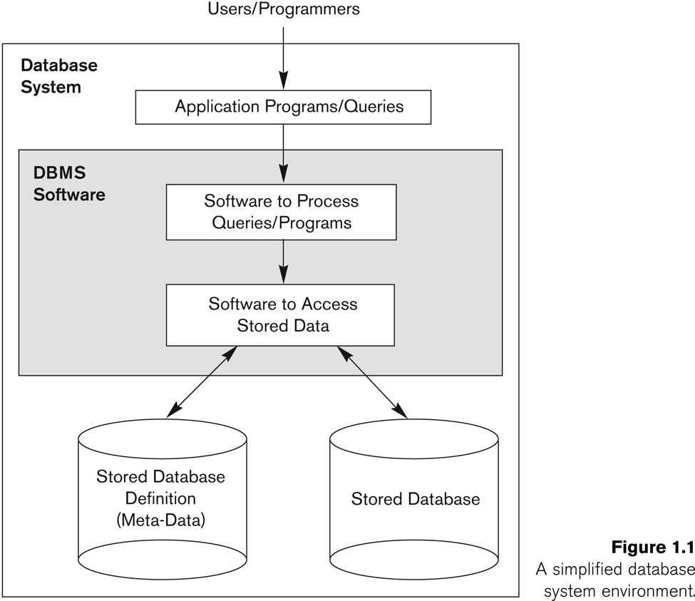
Simplified database system environment

Slide 3
the database system contains not only the database itself but also a complete definition or description of the database structure and constraints.
This definition is stored in the DBMS catalog,which contains information such as the structure of each file, the type and storage format of each data item, and various constraints on the data.
The information stored in the catalog is called meta-data,

Slide 4
Types of Databases and Database Applications
Slide 1- 4
Traditional Applications:
Numeric and Textual Databases
More Recent Applications:
Multimedia Databases
Geographic Information Systems (GIS)
Data Warehouses
Real-time and Active Databases
Many other applications
We will focus on traditional applications, with emphasis on scientific (biological) databases
Notes:
4

Slide 5
Typical DBMS Functionality
Define a particular database in terms of its data types, structures, and constraints
Construct or Load the initial database contents on a secondary storage medium
Manipulating the database:
Retrieval: Querying, generating reports
Modification: Insertions, deletions and updates to its content
Accessing the database through Web applications
Processing and Sharing by a set of concurrent users and application programs – yet, keeping all data valid and consistent

Slide 6
Typical DBMS Functionality
Other features:
Protection or Security measures to prevent unauthorized access
“Active” processing to take internal actions on data
Presentation and Visualization of data
Maintaining the database and associated programs over the lifetime of the database application

Slide 7
When not to use a DBMS
Main inhibitors (costs) of using a DBMS:
High initial investment and possible need for additional hardware.
Overhead for providing generality, security, concurrency control, recovery, and integrity functions.
When a DBMS may be unnecessary:
If the database and applications are simple, well defined, and not expected to change.
If there are stringent real-time requirements that may not be met because of DBMS overhead.
If access to data by multiple users is not required.

Slide 8
When not to use a DBMS
When no DBMS may suffice:
If the database system is not able to handle the complexity of data because of modeling limitations
If the database users need special operations not supported by the DBMS.

